Slide 1
The Kubernetes WebLogic Revival
Martien van den Akker
Frank Brink
2019

Slide 2
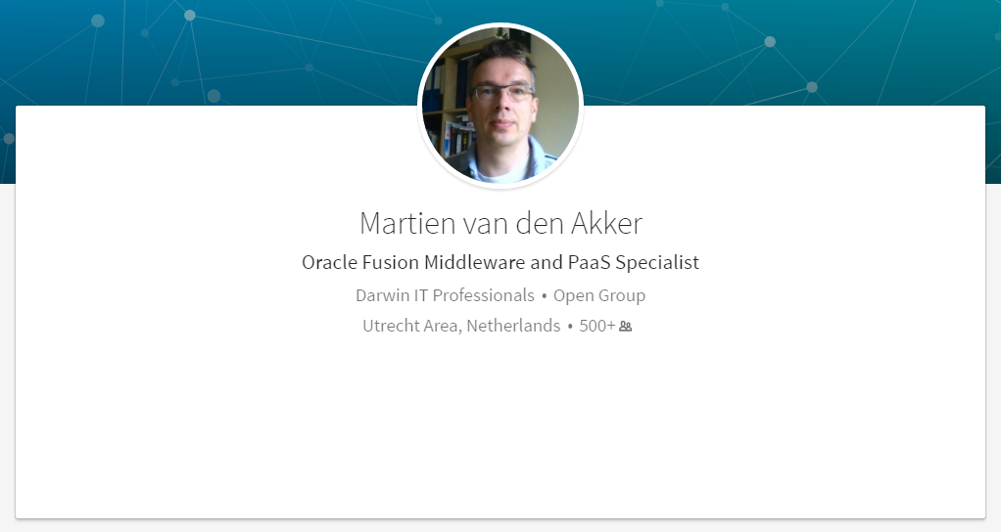


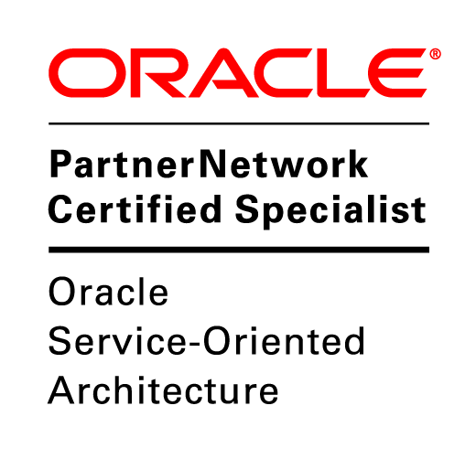

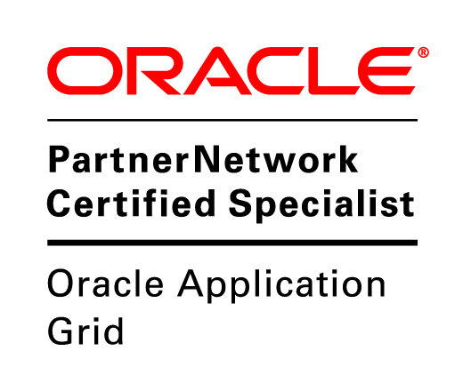


Who I am
martien.van.den.akker@darwin-it.nl
@Makker_nl

Slide 3

Who Frank Brink is
Senior Cloud Consultant
Certified Oracle Cloud Infrastructure 2018 Architect Associate
Oracle Middleware specialist
Frank.brink@darwin-it.nl

Slide 4
Agenda
1
What is Weblogic 12c?
Weblogic: what’s next?
Deploy Weblogic in Kubernetes
Topology models
Configuration overrides
HA/DR
Tooling
Demo
2
3
4
5
6
7
8
Notes:
4

Slide 5
What is Weblogic 12c?

Slide 6
JEE/Jakarta EE
Java Enterprise Edition – Jakarta Enterprise Edition
Set of specifications on top of Java SE
API’s and Frameworks such as
JDBC Datasources
JNDI (Java Naming Directory Interface)
JMS (Java Messaging Service)
WebServices/REST Services
Servlets/Java Server Pages/Java Server Faces
Reference: GlassFish Server OS, JEE 8 fully certified

Slide 7
Weblogic
Fully supports JEE 7 as of 12.2.1, JEE 8 as of 14.1
Commercial App Server, by BEA Systems
Acquired by Oracle in 2008
Strategic Application Server, replacing OC4J
(Oracle has 3 JEE AppServers…)
Very rich support for (amongst others)
Clustering
JDBC
High Availability
JMS
Diagnostics and Monitoring
REST & SOAP

Slide 8

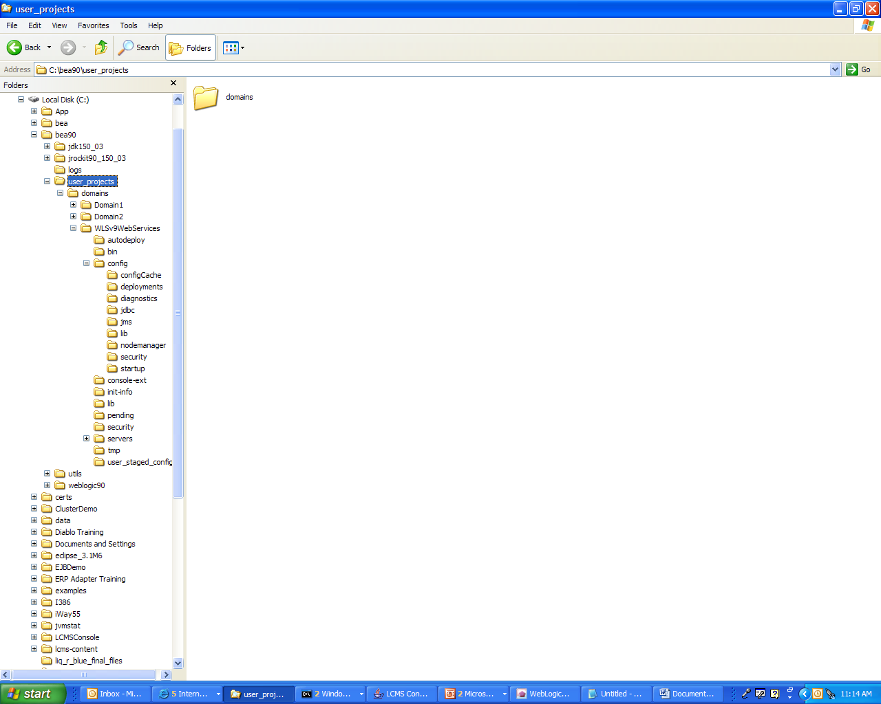
Domain Diagram
Domain
Cluster
Nodemanager Properties
Domain log
LOG
Machine 1
Get configuration
at startup.
Managed
server 1
Send
critical domain
notifications.
LOG
Local logging
Console
Administration
server
Log domain messages
Managed
server 2
Nodemanager Properties
Machine 2
GET/SET
LOG
Local logging
Monitor/ update
Managed
server 3
Configuration
repository
LOG
Local logging
Notes:
Domain Diagram
The diagram in the slide shows the critical components of a domain. A domain is an arbitrary logical administration unit that is managed by one administration server. A domain can encompass clusters in different geographies.
The administration server is responsible for providing configurations for all servers of a specific domain and for logging critical (configurable) notifications of the domain’s servers. It is also responsible for monitoring managed servers. A managed server is responsible for performing the business logic.
A managed server gets its configuration from the administration server at boot time. The managed server is then able to execute independently of the administration server. The administration server registers itself with each managed server so that it can receive critical notifications and run-time server state changes. Note that the only configuration folders and files that play a role are those of the administration server. The configuration folders and files of the managed servers are normally ignored because they download all configuration information from the administration server.
Configuration management is implemented through Java Management Extension (JMX). The communication between the managed servers and the administration server is via Remote Method Invocation (RMI), which also uses JMX.
Note: The diagram in the slide is a simplification; all the servers would be monitored by and updated from the administration server. Also, all the managed servers retrieve their configuration information at startup time from the administration server and log critical data to the administration server.

Slide 9
Weblogic HA Setup
Host 1 (Machine 1)
Host 2 (Machine 2)
Managed Server Domain (On Shared Storage)
Administration
server
Administration
server
Node Manager (per domain)
Node Manager (per domain)
Managed Server Domain (Clone from Admin Server Domain, Local Storage)
Managed Server Domain (Clone from Admin Server Domain,
Local Storage)
Cluster
Managed
server 1
Managed
server 2
Node Manager (per domain)
Managed
server 3
Managed
server 3
Node Manager (per domain)

Slide 10
Weblogic Clustering
Share resources (Deployments, Datasources, JMS)
Supports Service Migration and Whole Server Migration
12c+:
Dynamic Clustering, based on Server templates, supports scale up, scale down
Simpeler JMS Configuration, based on Dynamic Clusters
Chooses MS as Cluster Master to control cluster member health
Declarative configuration

Slide 11
Weblogic: what’s next?

Slide 12

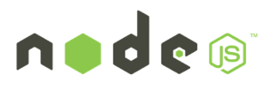






WebLogic, Coherence and Cloud Native Trends
Industry trends
Microservices, serverless
Private and public clouds
Containers, orchestration frameworks
WebLogic, Coherence customer demand
Leverage cloud neutral infrastructure
Integrate with new tools and services
Evolve WebLogic, Coherence for these environments
Blockchain
WebLogic
Coherence

Slide 13

Oracle Enterprise Java Strategy
Operator
WebLogic
Coherence
Evolve Products to Meet Customer Demand
Migrate to Kubernetes on premise
Tools for migration and management
Support existing and new applications
Migrate to Kubernetes on Oracle Cloud
Leverage management tools on OCI
Availability, security, scaling, low-cost
Integrate with Microservices
Flexibility for developers
Evolve and manage applications
Oracle Cloud and Other Clouds
Migrate
Operator
WebLogic
Coherence
WebLogic
Coherence
Physical & VMs On Premise
Kubernetes on Premise

Slide 14


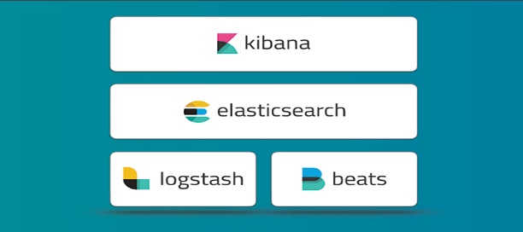
WebLogic on Kubernetes - Building Blocks
Operator
Docker and CRI-O certification
Docker images, Dockerfiles, examples
WebLogic Kubernetes certification
How-to, best practices
Value add integration
Management: Operator
Monitoring: Exporter for Prometheus
Migration: Deploy tooling
Logging: Exporter for Elastic Stack
Image Creation: WebLogic Image Tool
WebLogic
Coherence

Slide 15
WebLogic Domain in Kubernetes- Domain Custom Resource
We create a Kubernetes Resource Object for the WebLogic domain.
This is a data structure representation of the WebLogic domain in Kubernetes.
Domain Custom Resource allows you to declare or specify the desired state of the resource.
Allows the Kubernetes API server to begin serving the custom resource object.
The WebLogic Kubernetes Operator is a controller that is always looking at the Domain Custom Resource and tries to match the actual state to this desired state.
Domain Custom Resource
Meta Data: Name of Resource, Namespace, Labels, …
Admin Server: Node Ports to expose, Volumes, …
Cluster: Number of Replicas (Managed Servers), …
Domain: Image to base the Domain containers, Domain in PV or in Image, K8S secrets, Logs to pod
Managed Servers: non-clustered MS
Server Pod: Java Options, Start Policy (Lifecycle control)
Events:

Slide 16
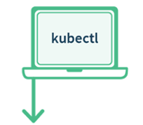



Why build the WebLogic Kubernetes Operator?
Contains built-in knowledge about how to perform lifecycle operations on a domain
Uses Kubernetes APIs to automate lifecycle operations.
Operator
Kubernetes
Orchestrate WebLogic
Manage
Pods
WLS Cluster
POD 1
POD 2
POD 3
POD 4
POD 5
POD 6
AS
MS
MS
MS
MS
MS
Kubernetes Cluster
Notes:
Operator is an application-specific controller that extends Kubernetes to create, configure, and manage instances of complex applications. The WebLogic Kubernetes Operator follows the standard Kubernetes Operator pattern,
Some of the things that the Operator does to simplify management and operations on the WebLogic domain and deployments
Create RBAC roles to manage Kubernetes resources on behalf of the WebLogic domain. Authorization to start/stop/.restart/create new domain.
Invokes the right Kubernetes APIs to start or stop servers, domains, clusters
the WebLogic Diagnostic framework Auto-scale setting rules in when the rule is met the Operator will invoke K8S API to scale the WebLogic cluster
When there is a new patched WebLogic image or a Application update initiate a rolling restart of the WebLogic domain

Slide 17
WebLogic Kubernetes Operator
1
Manages lifecycle operations (start, stop, scale, rolling restart, etc.) in Kubernetes
2
Automate configuration, e.g. clustering, channels/ports, configuration overrides
3
Supports standard k8s idioms like sidecars, init containers, custom resources
Open source and fully supported https://github.com/oracle/weblogic-kubernetes-operator

Slide 18
Deploy Weblogic in Kubernetes

Slide 19



WebLogic Domain in Kubernetes Operator
Customer Tenancy
Repository
WLS Domain Image
Domain Home in Image
Create OKE Cluster
Operator
Image
Kubernetes
Kubernetes
Build Image
Kubernetes Cluster
Kubernetes

Slide 20
Create Secrets
Customer Tenancy
Repository
Create secrets Wls and Docker Image Repository (OCIR)
WLS Domain Image
Operator
Image
Kubernetes
Kubernetes
Kubernetes Cluster
Secrets
Kubernetes

Slide 21

Install Weblogic Operator using Helm
Customer Tenancy
Repository
WLS Domain Image
Operator
Image
Kubernetes
Kubernetes Cluster
Secrets
Operator
Kubernetes

Slide 22
Install/Config Treafik LoadBalancer
Customer Tenancy
Repository
WLS Domain Image
Operator
Image
Kubernetes
Kubernetes Cluster
Secrets
Operator
Kubernetes

Slide 23
Possibly create persistent volume
Customer Tenancy
Repository
WLS Domain Image
Operator
Image
Kubernetes
Kubernetes Cluster
Secrets
Operator
Kubernetes

Slide 24
Create a Domain.yaml
Customer Tenancy
Repository
WLS Domain Image
Operator
Image
Kubernetes
Kubernetes Cluster
Secrets
Operator
Install Domain inputs (yaml)
Kubernetes

Slide 25
Apply Domain.yaml to CustomResource
Customer Tenancy
Repository
WLS Domain Image
Operator
Image
Kubernetes
Kubernetes
Domain CR
Kubernetes Cluster
Secrets
Operator
Install Domain inputs (yaml)
kubectl apply …
Kubernetes

Slide 26
Operator creating pods
Customer Tenancy
Repository
WLS Domain Image
Operator
Image
Kubernetes
Domain CR
Kubernetes Cluster
Secrets
Operator
WebLogic Domain(s)
WLS Cluster
POD 1
POD 2
POD 3
POD 4
POD 5
POD 6
AS
MS
MS
MS
MS
MS
Kubernetes
Logs

Slide 27
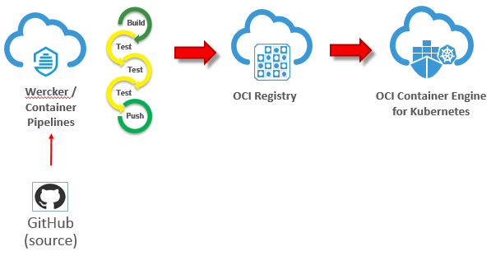
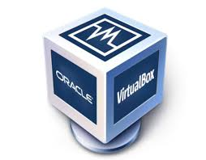
GitHub, Wercker, OCI Registry & OKE
Oracle Cloud Developer Services
Push
Kubernetes

Slide 28
Topology models

Slide 29
2 Topology Models
Options | Domain in PV/C | Domain in Image
Domain Topology Changes | Apply to domain in PV (wlst online) | New Image
Configuration Changes (tunables, credentials, …) | Change configuration in domain in PV | Overrides Only
Patching | New Image | CI/CD (new image)
Application Updates | Apply to domain in PV | CI/CD (new image)
Management of PV/PVC | More complex (filesystem shared per domain) | Simple (not shared, per server)
Administration Console | App deployments and Configuration Changes, can not do lifecycle mgt. | Monitoring and Diagnosis. Invalidate configuration changes.
Log Persistence | Supported (PV, Pod FS, Elastic Stack, Standard Out) | Supported (PV, Pod FS, Elastic Stack, Standard Out)
HA Across Availability Domain | Limited (requirement for shared PV) | Supported (No requirement for shared PV)
DR across Regions | Supported Active/Passive (like on Premise user responsible for sync domain config across DC) | Supported Active/Passive (easier, user does not need to sync domain config across DC)

Slide 30
Which model should I use?
The key difference is how updates are handled
Java updates
WebLogic patching
WebLogic configuration changes
Application updates
Are you fully embracing the CI/CD "DevOps" model and intend to manage change through that process?
E.g. create new images every time there is an update.
Are you making changes to configurations and deployments in running systems?
E.g. run WLST online to dynamically change your domain configuration.

Slide 31
Configuration overrides

Slide 32
Configuration Overrides
WebLogic Images containing Application, domain configuration, resources are immutable.
These Docker images must be portable
Development -> Testing -> Production.
Follow the customer’s CI/CD process.
Therefore, customers need a mechanism to override certain domain configuration
E.g. Provide data source URL and credentials

Slide 33
Domain Introspection and Config Override Generation
Introspection Job
WLS Domain Image
Domain
Customer provided override templates
Scan domain configuration for topology and to validate
Generation of final configuration overrides
Operator
Operator overrides

Slide 34
User Configuration Overrides
Typical attributes for overrides include:
User names, passwords, and URLs for:
JDBC datasources
JMS bridges, foreign servers, and SAF
Network channel public addresses:
For remote RMI clients (T3, JMS, EJB, JTA)
For remote WLST clients
Debugging
Tuning (MaxMessageSize, etc.)

Slide 35
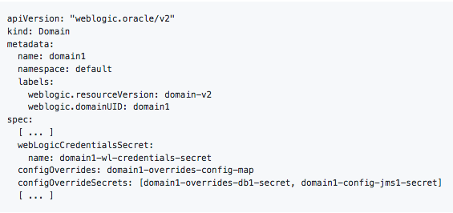
Configuration Overrides
Create a Kubernetes configuration map that contains:
Override templates
Create Kubernetes secrets that contains:
Data source username and password.
Set your domain CR
Config map.
Secret with the Config Override
Start or restart your domain.

Slide 36
Assign Pods to Nodes

Slide 37
Assigning WebLogic Pods to Nodes
Use Node Selector to constrain a pod to only be able to run on particular nodes.
Assign a label (key=value) to the node:
kubectl label nodes kubernetes-foo-node-1 licensed-for-weblogic=true
Edit the Domain Custom Resource at the domain/cluster/server level and assign key:value nodeSelector.
Edit Domain CR
Domain Custom Resource
serverPod:
nodeSelector:
licensed-for-weblogic: true

Slide 38

Assigning WebLogic Pods to Nodes
Assign pods to Nodes based on resources, e.g. CPU and Memory usage
A Pod is scheduled to run on a Node only if the Node has enough CPU resources available.
Edit Domain CR
Domain Custom Resource
serverPod:
resources:
requests:
memory: "8Gb"
cpu: "250m"
limits:
memory: "128Mi"
cpu: "500m"`

Slide 39

Inter-Pod Affinity and Anti-Affinity
Which K8s nodes to schedule or re-schedule pods with respect to other WebLogic pods
Possible types of Node affinity/anti-affinity:
Preferred (soft affinity)
Required (hard affinity)
Match labels for Affinity/Anti-affinity
Operator: In
Operator: Exists
Operator: NotIn
Operator: DoesNotExist
Edit Domain CR
serverPod:
affinity: podAntiAffinity:
preferredDuringSchedulingIgnoredDuringExecution:
- labelSelector:
matchExpressions:
- key: "weblogic.clusterName"
operator: In
values: - cluster-1
topologyKey: "kubernetes.io/hostname"

Slide 40
WLS POD2
Operator
Schedule
Node 1
Node 2
Node 3
WLS POD1
weblogic.clusterName
Licensed-for-weblogic
Licensed-for-weblogic
nodeSelector:
licensed-for-weblogic: true
affinity: podAntiAffinity:
preferredDuringSchedulingIgnoredDuringExecution:
- labelSelector:
matchExpressions:
- key: "weblogic.clusterName"
operator: In

Slide 41
Operator
Node 1
Node 2
Node 3
WLS POD1
WLS POD2
weblogic.clusterName
weblogic.clusterName
Licensed-for-weblogic
Licensed-for-weblogic
nodeSelector:
licensed-for-weblogic: true
affinity: podAntiAffinity:
preferredDuringSchedulingIgnoredDuringExecution:
- labelSelector:
matchExpressions:
- key: "weblogic.clusterName"
operator: In

Slide 42
WLS POD3
Operator
Schedule
Node 1
Node 2
Node 3
WLS POD1
WLS POD2
weblogic.clusterName
weblogic.clusterName
Licensed-for-weblogic
Licensed-for-weblogic
nodeSelector:
licensed-for-weblogic: true
affinity: podAntiAffinity:
preferredDuringSchedulingIgnoredDuringExecution:
- labelSelector:
matchExpressions:
- key: "weblogic.clusterName"
operator: In

Slide 43
Operator
Node 1
Node 2
Node 3
WLS POD1
WLS POD3
WLS POD2
weblogic.clusterName
weblogic.clusterName
weblogic.clusterName
Licensed-for-weblogic
Licensed-for-weblogic
nodeSelector:
licensed-for-weblogic: true
affinity: podAntiAffinity:
preferredDuringSchedulingIgnoredDuringExecution:
- labelSelector:
matchExpressions:
- key: "weblogic.clusterName"
operator: In

Slide 44
HA and DR in Kubernetes

Slide 45




WebLogic High Availability
WebLogic High Availability across Data Centers with WebLogic Stretch Clusters.
Span a WebLogic domain across several Availability Domains
Single Kubernetes Cluster
AD 1
AD 2
AD 3
WebLogic domain

Slide 46
WebLogic Disaster Recovery
WebLogic DR across Regions made easier
WebLogic domain image contains complete domain configuration
State needs to be externalized to Database
Region A
WLS Domain image
Region B

Slide 47
Tooling

Slide 48

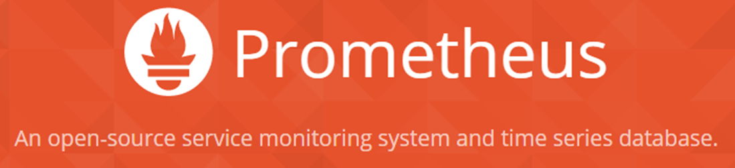
WebLogic Monitoring Exporter
Monitoring Exporter enables Prometheus monitoring of WebLogic
Standard monitoring tools can be used for monitoring WebLogic
Grafana Dashboards used for visualization
Prometheus auto-scaling of WebLogic cluster
Prometheus and Grafana example GitHub Sample
Operator
Scale
WLS
Kubernetes
Kubernetes
Monitor
WebLogic
WebLogic
WebLogic
MS
MS

Slide 49
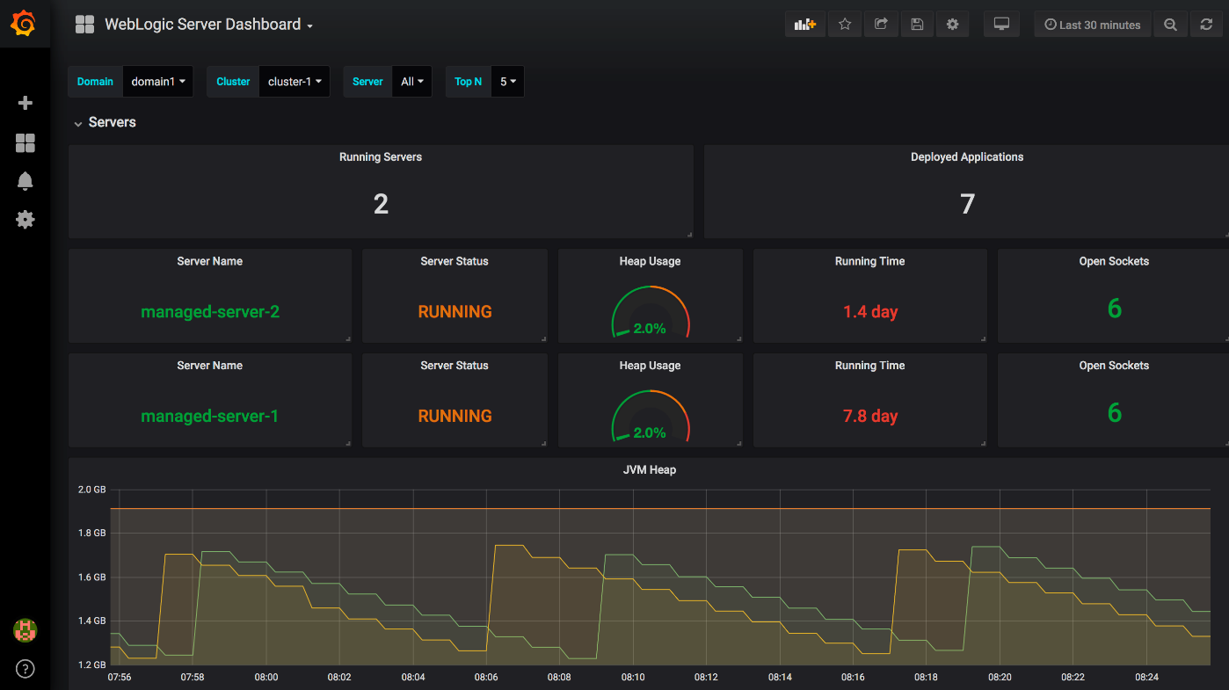
Out of the Box Grafana Dashboards

Slide 50
WebLogic Deploy Tooling
Introspect domains
WebLogic 10.3.6, 12.1.3, 12.2.1.X
Create a model (yaml) of the domain
Migrate existing domains and applications Upgrade (if required) to 12.2.1.X
Customize and Validate configuration to meet Kubernetes requirements
Create domains in Docker image GitHub Sample
WebLogic Deploy Tooling
Domain Model
WebLogic
WebLogic
WebLogic

Slide 51

WebLogic Logging Exporter
Logging Exporter enables exporting WebLogic server logs to the Elastic Stack
Store logs in the Elastic Stack
Search and analyze logs in Elastichsearch
Display logs in dashboards in Kibana
Integrate with FluentD (future)
GitHub weblogic-logging-exporter
Operator
Kubernetes
Kubernetes
WebLogic
WebLogic
WebLogic
MS
MS

Slide 52
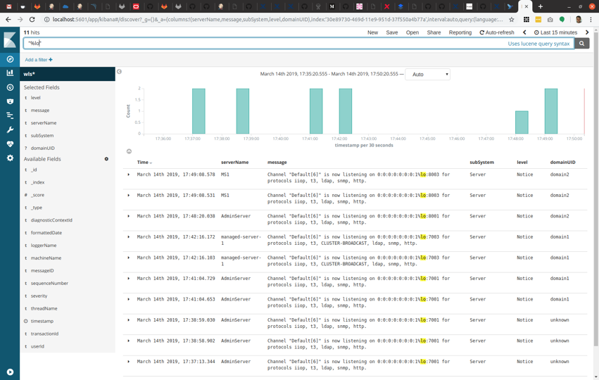
Kibana Dashboards

Slide 53

Patching WL Image with WebLogic Image Tool
Future
Repository
My Oracle Support
Operator
Image
Download
p29135930 & p27117282
WLS Domain Image
Kubernetes
WLS Image Tool
WLS 12.2.1.3 Binary Image
Use cases
Apply patches p29135930 & p27117282
Build image from scratch
WLS 12.2.1.3
JDK 8_u201
OL 7.5
p29135930 & p27117282
WebLogioc 12.2.1.3 binaries
Server JRE
Build image from already existing image
Oracle Linux
Apply patches p29135930 & p27117282
WLS 12.2.1.3 patched Binary Image
WLS 12.2.1.3 Binary Image from Repository
p29135930 & p27117282
WLS 12.2.1.3 Binary Image
Build domain image based on WLS 12.2.1.3
WLS 12.2.1.3
p29135930 & p27117282
Domain yaml model & Application binaries
With WDT build a domain image with application
WLS Domain Image Patched
WLS 12.2.1.3 patched Binary Image

Slide 54
Demo Weblogic within OKE cluster

Slide 55

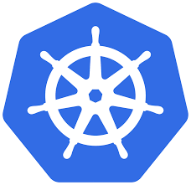
OKE Cluster and its VCN context
ORACLE CLOUD DATA CENTER REGION (Frankfurt)
AVAILABILITY DOMAIN-1
AVAILABILITY DOMAIN-2
AVAILABILITY DOMAIN-3
10.0.10.4
10.0.10.2
10.0.10.3
OKE-1
OKE-2
OKE-0
OKE Cluster
Wkr Security List
Regional Private SUBNET A,10.0.10.0/24
130.61.12.8
LB
LB Security List
Regional Public SUBNET A,10.0.20.0/24
OKE VCN, 10.0.0.0/16
Medreck8s Compartment

Slide 56
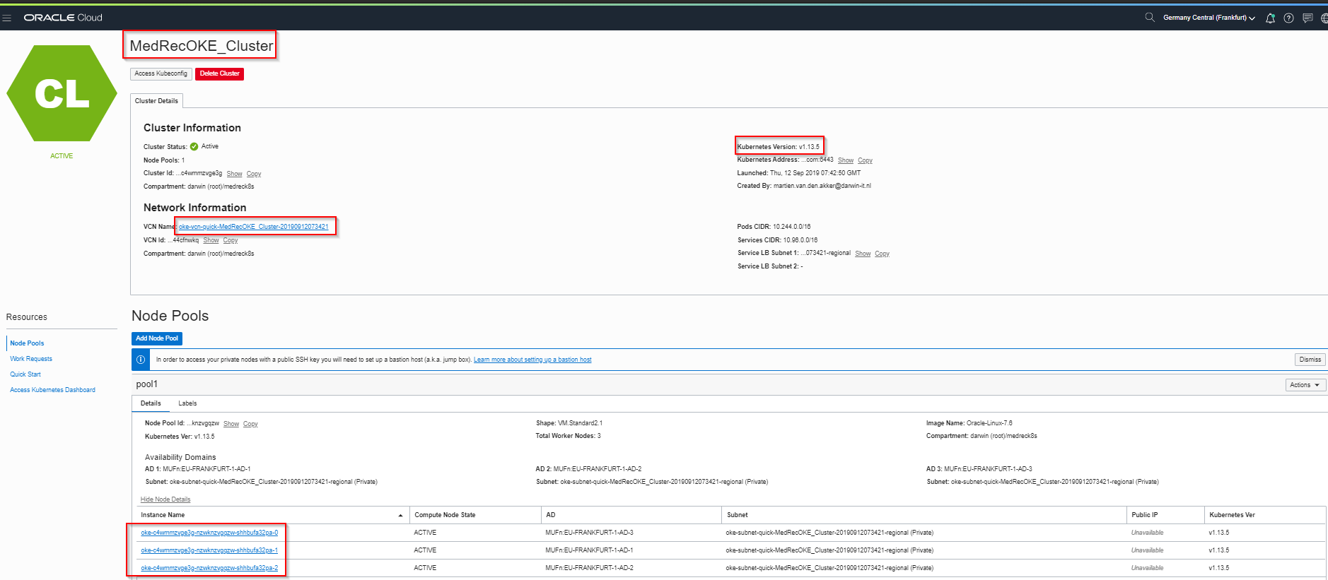
OKE Cluster within OCI Console
ORACLE CLOUD DATA CENTER REGION (Frankfurt)
AVAILABILITY DOMAIN-1
AVAILABILITY DOMAIN-2
AVAILABILITY DOMAIN-3
10.0.10.4
10.0.10.2
10.0.10.3
OKE-1
OKE-2
OKE-0
OKE Cluster
Wkr Security List
Regional Private SUBNET A,10.0.10.0/24
130.61.12.8
LB
LB Security List
Regional Public SUBNET A,10.0.20.0/24
OKE VCN, 10.0.0.0/16
Medreck8s Compartment

Slide 57
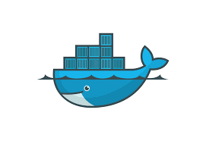
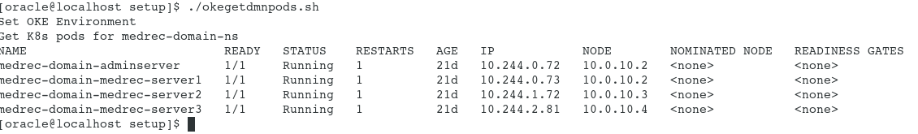
Weblogic running within an OKE Cluster
ORACLE CLOUD DATA CENTER REGION (Frankfurt)
AVAILABILITY DOMAIN-1
AVAILABILITY DOMAIN-2
AVAILABILITY DOMAIN-3
AdmSrv
10.244.2.45
10.0.10.4
10.0.10.2
10.0.10.3
Srv-2
10.244.0.56
Srv-3
10.244.1.40
Srv-1
10.244.2.46
OKE-1
OKE-2
OKE-0
OKE Cluster
Wkr Security List
Regional Private SUBNET A,10.0.10.0/24
130.61.12.8
LB
LB Security List
Regional Public SUBNET A,10.0.20.0/24
OKE VCN, 10.0.0.0/16
Medreck8s Compartment

Slide 58
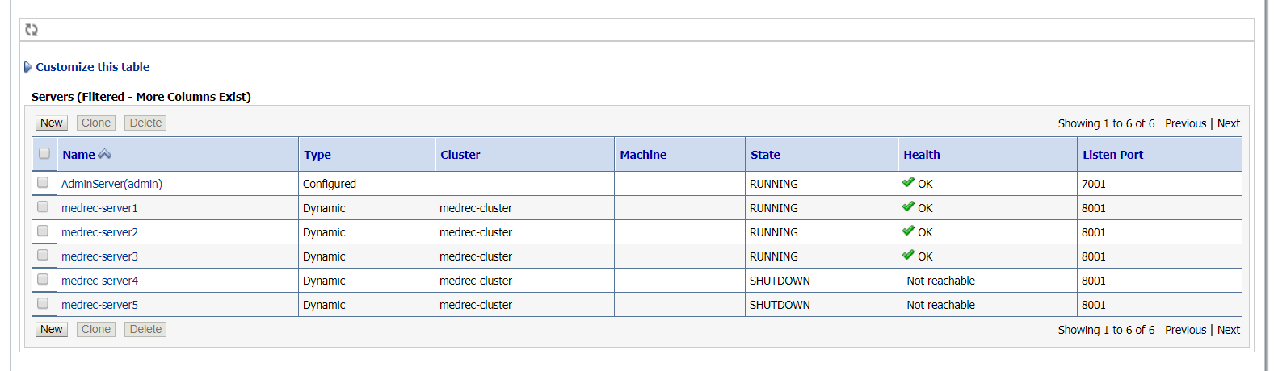
Managed servers within weblogic domain running on a OKE cluster
ORACLE CLOUD DATA CENTER REGION (Frankfurt)
AVAILABILITY DOMAIN-1
AVAILABILITY DOMAIN-2
AVAILABILITY DOMAIN-3
AdmSrv
10.244.2.45
10.0.10.4
10.0.10.2
10.0.10.3
Srv-2
10.244.0.56
Srv-3
10.244.1.40
Srv-1
10.244.2.46
OKE-1
OKE-2
OKE-0
OKE Cluster
Wkr Security List
Regional Private SUBNET A,10.0.10.0/24
130.61.12.8
LB
LB Security List
Regional Public SUBNET A,10.0.20.0/24
OKE VCN, 10.0.0.0/16
Medreck8s Compartment

Slide 59
How to access a managed database outside an OKE cluster?
ORACLE CLOUD DATA CENTER REGION (Frankfurt)
AVAILABILITY DOMAIN-1
AVAILABILITY DOMAIN-2
AVAILABILITY DOMAIN-3
AdmSrv
10.244.2.45
10.0.10.4
10.0.10.2
10.0.10.3
Srv-2
10.244.0.56
Srv-3
10.244.1.40
Srv-1
10.244.2.46
OKE-1
OKE-2
OKE-0
10.0.10.6
OKE Cluster
10.96.72.93
Wkr Security List
DBHost
Regional Private SUBNET A,10.0.10.0/24
LB Security List
130.61.12.8
LB
Regional Public SUBNET A,10.0.20.0/24
OKE VCN, 10.0.0.0/16
Medreck8s Compartment

Slide 60
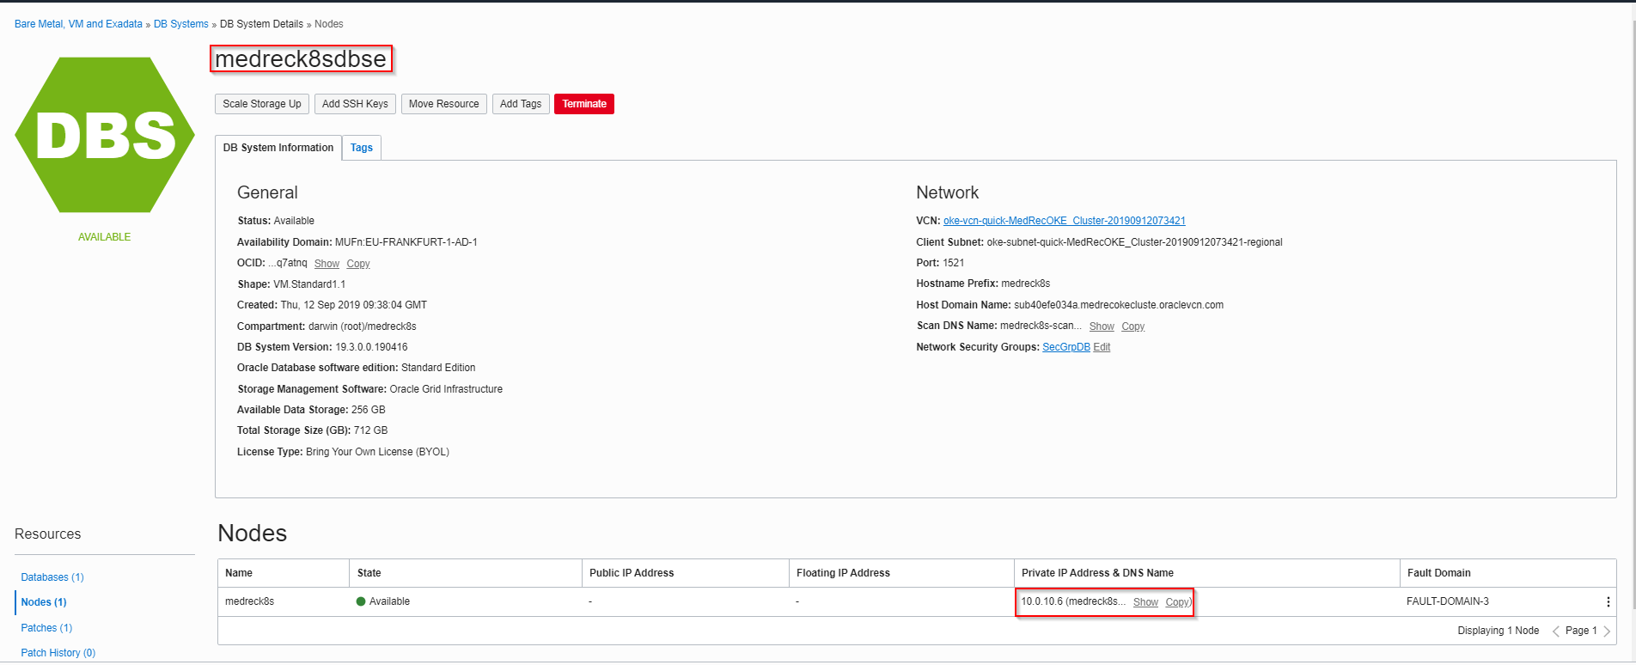
Running managed database in OCI console within same subnet as OKE cluster
ORACLE CLOUD DATA CENTER REGION (Frankfurt)
AVAILABILITY DOMAIN-1
AVAILABILITY DOMAIN-2
AVAILABILITY DOMAIN-3
AdmSrv
10.244.2.45
10.0.10.4
10.0.10.2
10.0.10.3
Srv-2
10.244.0.56
Srv-3
10.244.1.40
Srv-1
10.244.2.46
OKE-1
OKE-2
OKE-0
10.0.10.6
OKE Cluster
10.96.72.93
Wkr Security List
DBHost
Regional Private SUBNET A,10.0.10.0/24
LB Security List
130.61.12.8
LB
Regional Public SUBNET A,10.0.20.0/24
OKE VCN, 10.0.0.0/16
Medreck8s Compartment

Slide 61

Runtime access to a managed database via a k8s service
ORACLE CLOUD DATA CENTER REGION (Frankfurt)
AVAILABILITY DOMAIN-1
AVAILABILITY DOMAIN-2
AVAILABILITY DOMAIN-3
AdmSrv
10.244.2.45
10.0.10.4
10.0.10.2
10.0.10.3
Srv-2
10.244.0.56
Srv-3
10.244.1.40
Srv-1
10.244.2.46
OKE-1
OKE-2
OKE-0
10.0.10.6
OKE Cluster
medrecdbhostname sk8s service op 1521
10.96.104.28
Wkr Security List
DBHost
Regional Private SUBNET A,10.0.10.0/24
LB Security List
130.61.12.8
LB
Regional Public SUBNET A,10.0.20.0/24
OKE VCN, 10.0.0.0/16
Medreck8s Compartment

Slide 62
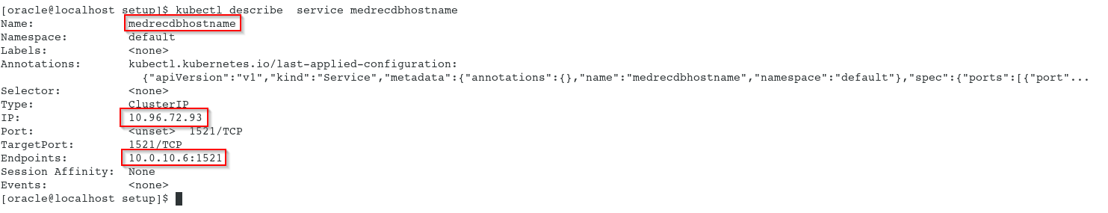
k8s service medrecdbhostname details with kubectl
ORACLE CLOUD DATA CENTER REGION (Frankfurt)
AVAILABILITY DOMAIN-1
AVAILABILITY DOMAIN-2
AVAILABILITY DOMAIN-3
AdmSrv
10.244.2.45
10.0.10.4
10.0.10.2
10.0.10.3
Srv-2
10.244.0.56
Srv-3
10.244.1.40
Srv-1
10.244.2.46
OKE-1
OKE-2
OKE-0
10.0.10.6
OKE Cluster
medrecdbhostname sk8s service op 1521
10.96.72.93
Wkr Security List
DBHost
Regional Private SUBNET A,10.0.10.0/24
LB Security List
130.61.12.8
LB
Regional Public SUBNET A,10.0.20.0/24
OKE VCN, 10.0.0.0/16
Medreck8s Compartment

Slide 63
Demo Down and Up Sizing a Weblogic Domain: more/less managed servers
ORACLE CLOUD DATA CENTER REGION (Frankfurt)
AVAILABILITY DOMAIN-1
AVAILABILITY DOMAIN-2
AVAILABILITY DOMAIN-3
AdmSrv
10.244.2.45
10.0.10.4
10.0.10.2
10.0.10.3
Srv-2
10.244.0.56
Srv-3
10.244.1.40
Srv-1
10.244.2.46
OKE-1
OKE-2
OKE-0
OKE Cluster
Wkr Security List
Regional Private SUBNET A,10.0.10.0/24
130.61.12.8
LB
LB Security List
Regional Public SUBNET A,10.0.20.0/24
OKE VCN, 10.0.0.0/16
Medreck8s Compartment

Slide 64
Generated Security Lists per (regional subnet) applicable for all nodes within SN
Stateless Ingress rules for a limited set ip address – all protocols
Stateful Ingress rules for all nodes on port 22
Stateful Ingress rules for a limited set ip address –for a specific set of ports
Statefull Egress rules to all (worldwide) ip address for all protocols
Stateless Egress rules to a limited set (internal) ip address – all protocols
ORACLE CLOUD DATA CENTER REGION (Frankfurt)
AVAILABILITY DOMAIN-1
AVAILABILITY DOMAIN-2
AVAILABILITY DOMAIN-3
10.0.10.4
10.0.10.2
10.0.10.3
OKE-1
OKE-2
OKE-0
OKE Cluster
Wkr Security List
Regional Private SUBNET A,10.0.10.0/24
Stateless Ingress rules for all worldwide ip address – all protocols
Statefull Ingress rules for all worldwide ip address – on port 80 and 443
Stateless Egress rules to all (worldwide) ip address for all protocols
Statefull Egress rules to a limited set (internal) ip address on port 10256
LB Security List
130.61.12.8
LB
Regional Public SUBNET A,10.0.20.0/24
OKE VCN, 10.0.0.0/16
Medreck8s Compartment

Slide 65
Creation of a managed database on a private subnet (and a BH for maintenance)
ORACLE CLOUD DATA CENTER REGION (Frankfurt)
AVAILABILITY DOMAIN-1
AVAILABILITY DOMAIN-2
AVAILABILITY DOMAIN-3
10.0.10.6
Wkr Security List
DBHost
Regional Private SUBNET A,10.0.10.0/24
10.0.20.2
130.61.91.64
BastionHost
LB Security List
Regional Public SUBNET A,10.0.20.0/24
OKE VCN, 10.0.0.0/16
Medreck8s Compartment

Slide 66
Managed Database Creation
Private Subnet (use PSN created by the OKE cluster)
Database Shape/Edition/Release/BYOL versus fully licenses
VM.Standard1.1;SE/19.x/BYOL
Access
Design Time via BH (tunneling)
Runtime (Weblogic within OKE cluster) via k8s service
Security lists and/or Security groups
Incoming (ingress) traffic: which node/ip/protocol?
PDB/CDB (default multitenant since release 19.x)
OCI Console provides connect String to CDB
PDB connect string
Select * from v$Services
SSH to DBHOST
Query listener status

Slide 67
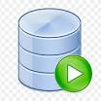

Design time connection to managed database in private subnet
ORACLE CLOUD DATA CENTER REGION (Frankfurt)
AVAILABILITY DOMAIN-1
AVAILABILITY DOMAIN-2
AVAILABILITY DOMAIN-3
10.0.10.6
Wkr Security List
DBHost
Regional Private SUBNET A,10.0.10.0/24
10.0.20.2
130.61.91.64
BastionHost
LB Security List
Regional Public SUBNET A,10.0.20.0/24
OKE VCN, 10.0.0.0/16
Medreck8s Compartment

Slide 68
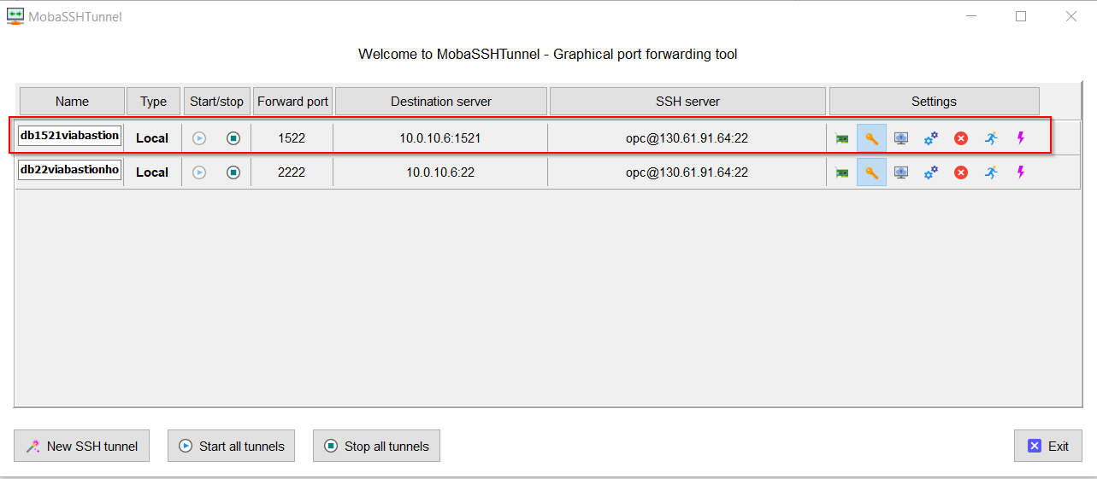
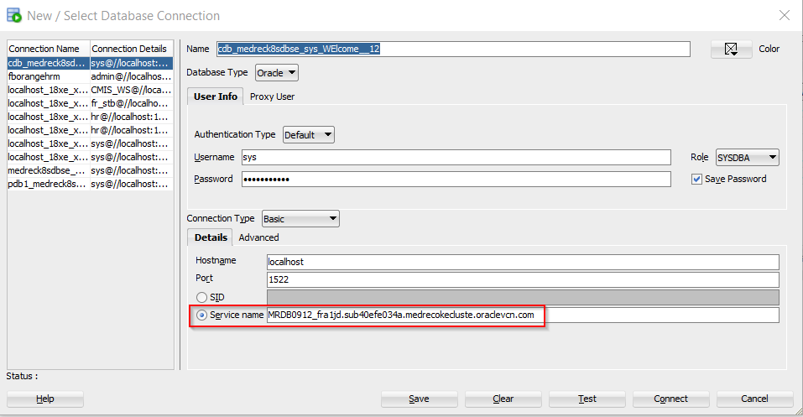
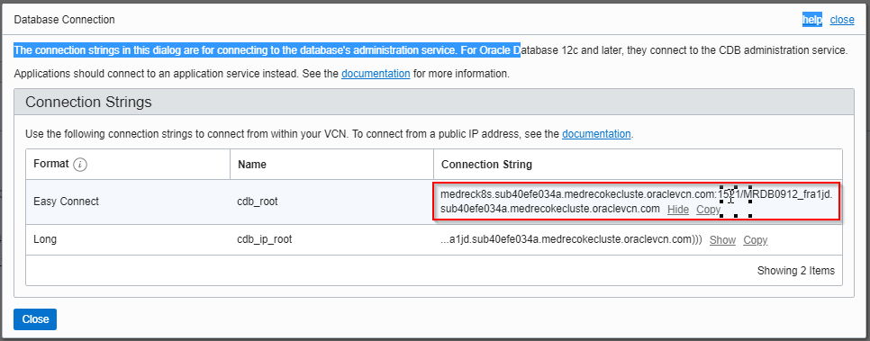
Design Time Connection (tunneling)

Slide 69
Network Security rules via additional security groups (next to security lists)
ORACLE CLOUD DATA CENTER REGION (Frankfurt)
Ingress:SecGrpBHIng|22
Egress:0.0.0.0/0|all
AVAILABILITY DOMAIN-1
AVAILABILITY DOMAIN-2
AVAILABILITY DOMAIN-3
SecGrpWL
SecGrpWL
SecGrpWL
AdmSrv
10.244.2.45
10.0.10.4
10.0.10.2
10.0.10.3
Srv-2
10.244.0.56
Srv-3
10.244.1.40
Srv-1
10.244.2.46
OKE-1
OKE-2
OKE-0
10.0.10.6
OKE Cluster
Ingres:SecGrpBH|1521
Ingres: SecGrpBHICMP
Ingres:SecGrpWL:1521
medrecdbhostname sk8s service op 1521
Wkr Security List
DBHost
SecGrpDB
Regional Private SUBNET A,10.0.10.0/24
Ingress:0.0.0.0/0|22 (SSH)
Ingress:0.0.0.0/03389 (RDP)
Ingress:0.0.0.0/0ICMP
10.0.20.2
130.61.91.64
BastionHost
SecGrpBH
LB Security List
130.61.12.8
LB
Regional Public SUBNET A,10.0.20.0/24
OKE VCN, 10.0.0.0/16
Medreck8s Compartment

Slide 70
Wrapping up…

Slide 71
Links
Oracle Weblogic Kubernetes Operator
https://oracle.github.io/weblogic-kubernetes-operator
Oracle Weblogic Kubernetes Operator Samples
https://oracle.github.io/weblogic-kubernetes-operator/samples/
Oracle Weblogic Slack Inviter
https://weblogic-slack-inviter.herokuapp.com/
Cloud Customer Connect – Containers and Kubernetes forum
https://cloudcustomerconnect.oracle.com/resources/654ff18469/summary
OPN PaasForum/SummerCamps ’19 Tutorial by Peter Nagy (to be forked)
https://github.com/nagypeter/weblogic-operator-tutorial
End2End example monitoring wl server with Grafana dashboards
https://blogs.oracle.com/weblogicserver/end-to-end-example-of-monitoring-weblogic-server-with-grafana-dashboards-on-the-oci-container-engine-for-kubernetes

Slide 72
Thank you for your attendance, patience and attention

Slide 73

Q & A

